Slide 1

Android App Platform
Overview

Slide 2
Overview
Android App Architecture Overview
Intents In Android
Types Of Intents Data Flow In Intents

Slide 3
Android App Architecture Overview
Basic components:
Activities, Services, Broadcast Receivers, Content Providers
Android allows applications to communicate between processes through intents, which not only provides convenience for data sharing but also brings many hidden dangers. If developers do not properly dispose of intents transmitted between processes, it may lead to security vulnerabilities such as information leakage, permission escalation, and arbitrary code execution.

Slide 4
Activity In Android App

Slide 5
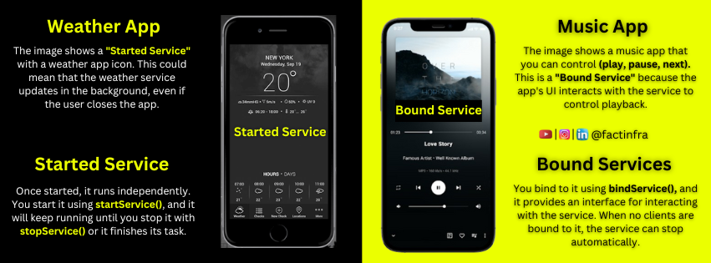
Services In Android App

Slide 6
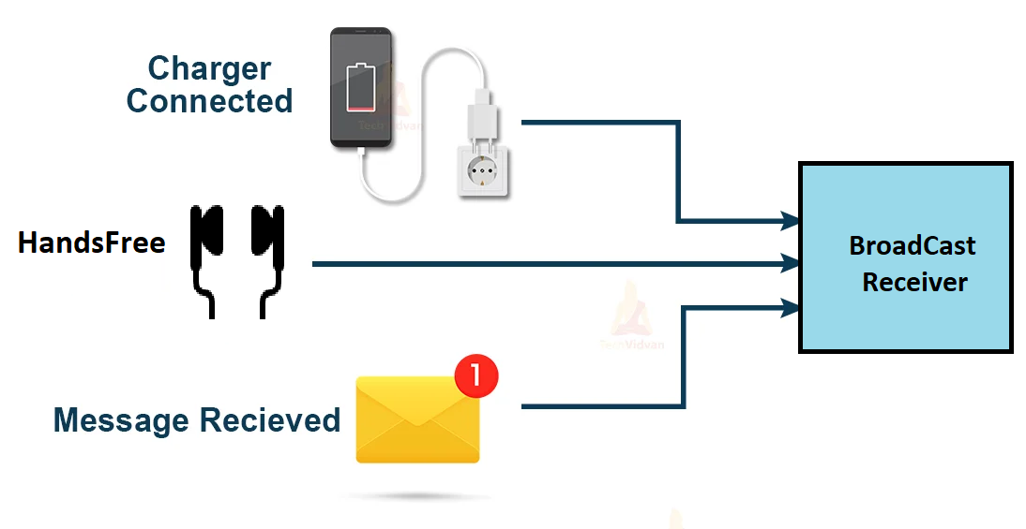
Broadcast Receiver In Android App

Slide 7
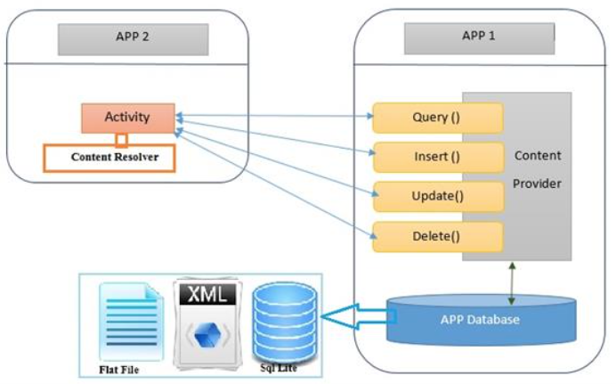
Content Provider In Android App

Slide 8
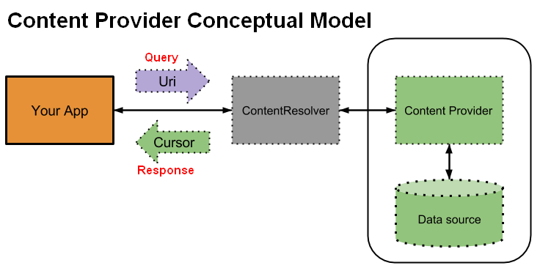

Slide 9
Intents In Android
Intent = A message or request that Android uses to start something or send something.
What Can Intents Do?
Start a new screen (Activity)
Start a background task (Service)
Send a system-wide message (Broadcast)
Open another app's feature (like Gallery, Maps, etc.)

Slide 10
Intent is a messaging object used to request an action from another app component, like opening a new activity, sending data, or starting a service.
It facilitates communication between different parts of an app or between different apps.
Types Of Intents
Explicit Intents
Implicit Intents
An explicit intent clearly tells Android which exact component (Activity, Service, etc.) to start. 👉 You use it when you're starting something inside your own app.
An implicit intent does not say the exact component. Instead, it says: "I want to do this action – find an app that can handle it."
👉 Android searches for apps that can perform that action.
Example: Start another screen in the same app
Intent intent = new Intent(this, ProfileActivity.class); startActivity(intent);
This tells Android: "Open the ProfileActivity screen in this app."
Example: Open a website in any browser
Intent intent = new Intent(Intent.ACTION_VIEW); intent.setData(Uri.parse("https://www.google.com")); startActivity(intent);
This tells Android: "I want to view this website – you choose which app (Chrome, Firefox, etc.)."

Slide 11
Data Flow In Intents
Sending Data (from MainActivity to SecondActivity):
Intent intent = new Intent(MainActivity.this, SecondActivity.class); intent.putExtra("userName", ”Pooja"); startActivity(intent);
Receiving Data (in SecondActivity):
Intent intent = getIntent(); String userName = intent.getStringExtra("userName"); // Use the received data

Slide 12
References:
https://app.hextree.io/map/android
https://github.com/payatu/BugBazaar
https://medium.com/@pujapawar/part4-prerequisite-to-learn-mobile-app-security-testing-2f9345a4ba15
https://itsfading.github.io/posts/HexTree-Attack-Surface-App-Solutions/
https://security.tecno.com/SRC/blogdetail/264?lang=en_US

Slide 13
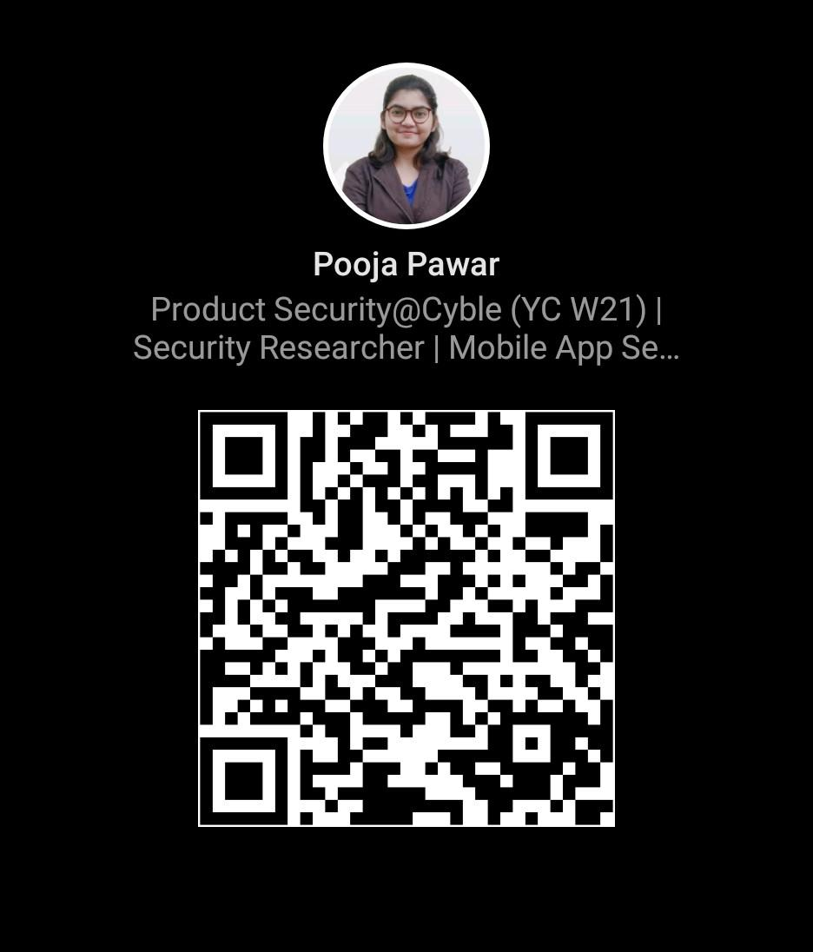
Thank You!

